Slide 1
How Can You Help?
Sign up to volunteer in your community
Host a backpack packing party
Host a diaper drive
Become a foster parent
Cook a meal for a cottage or foster family
For more: OneMoreChild.org
Notes:
THIS SHOULD BE THE PRIMARY ONE USED WHEN DESCRIBING OPPORTUNITIES TO GET INVOLVED – If you need one specifically for your ministry, please contact the Communications Team to work with you to create one.

Slide 2
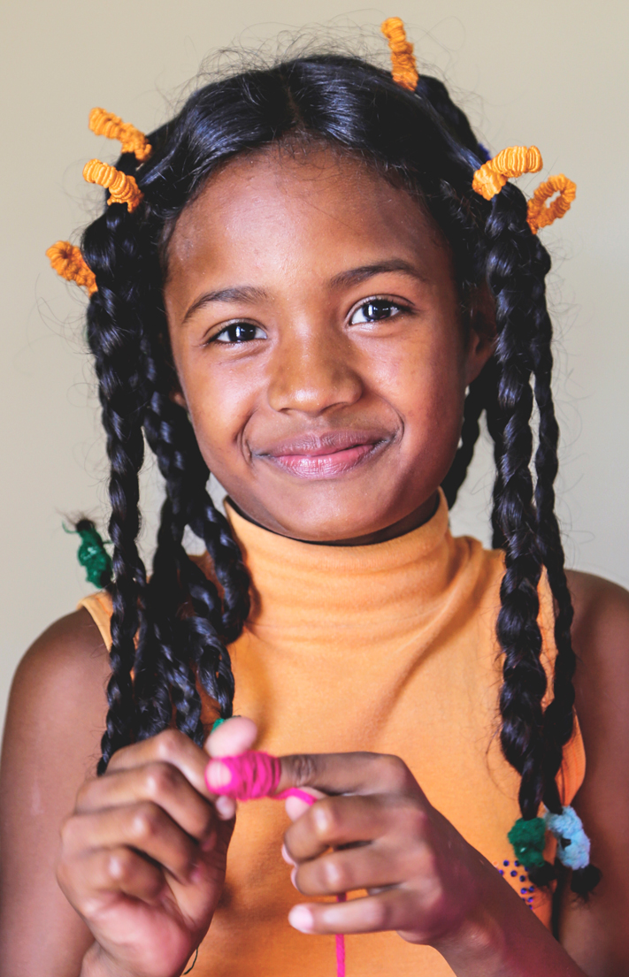
Real Kids, Real Needs
Stat 1
Stat 2
Stat 3
Stat 4
Stat 5

