Slide 1
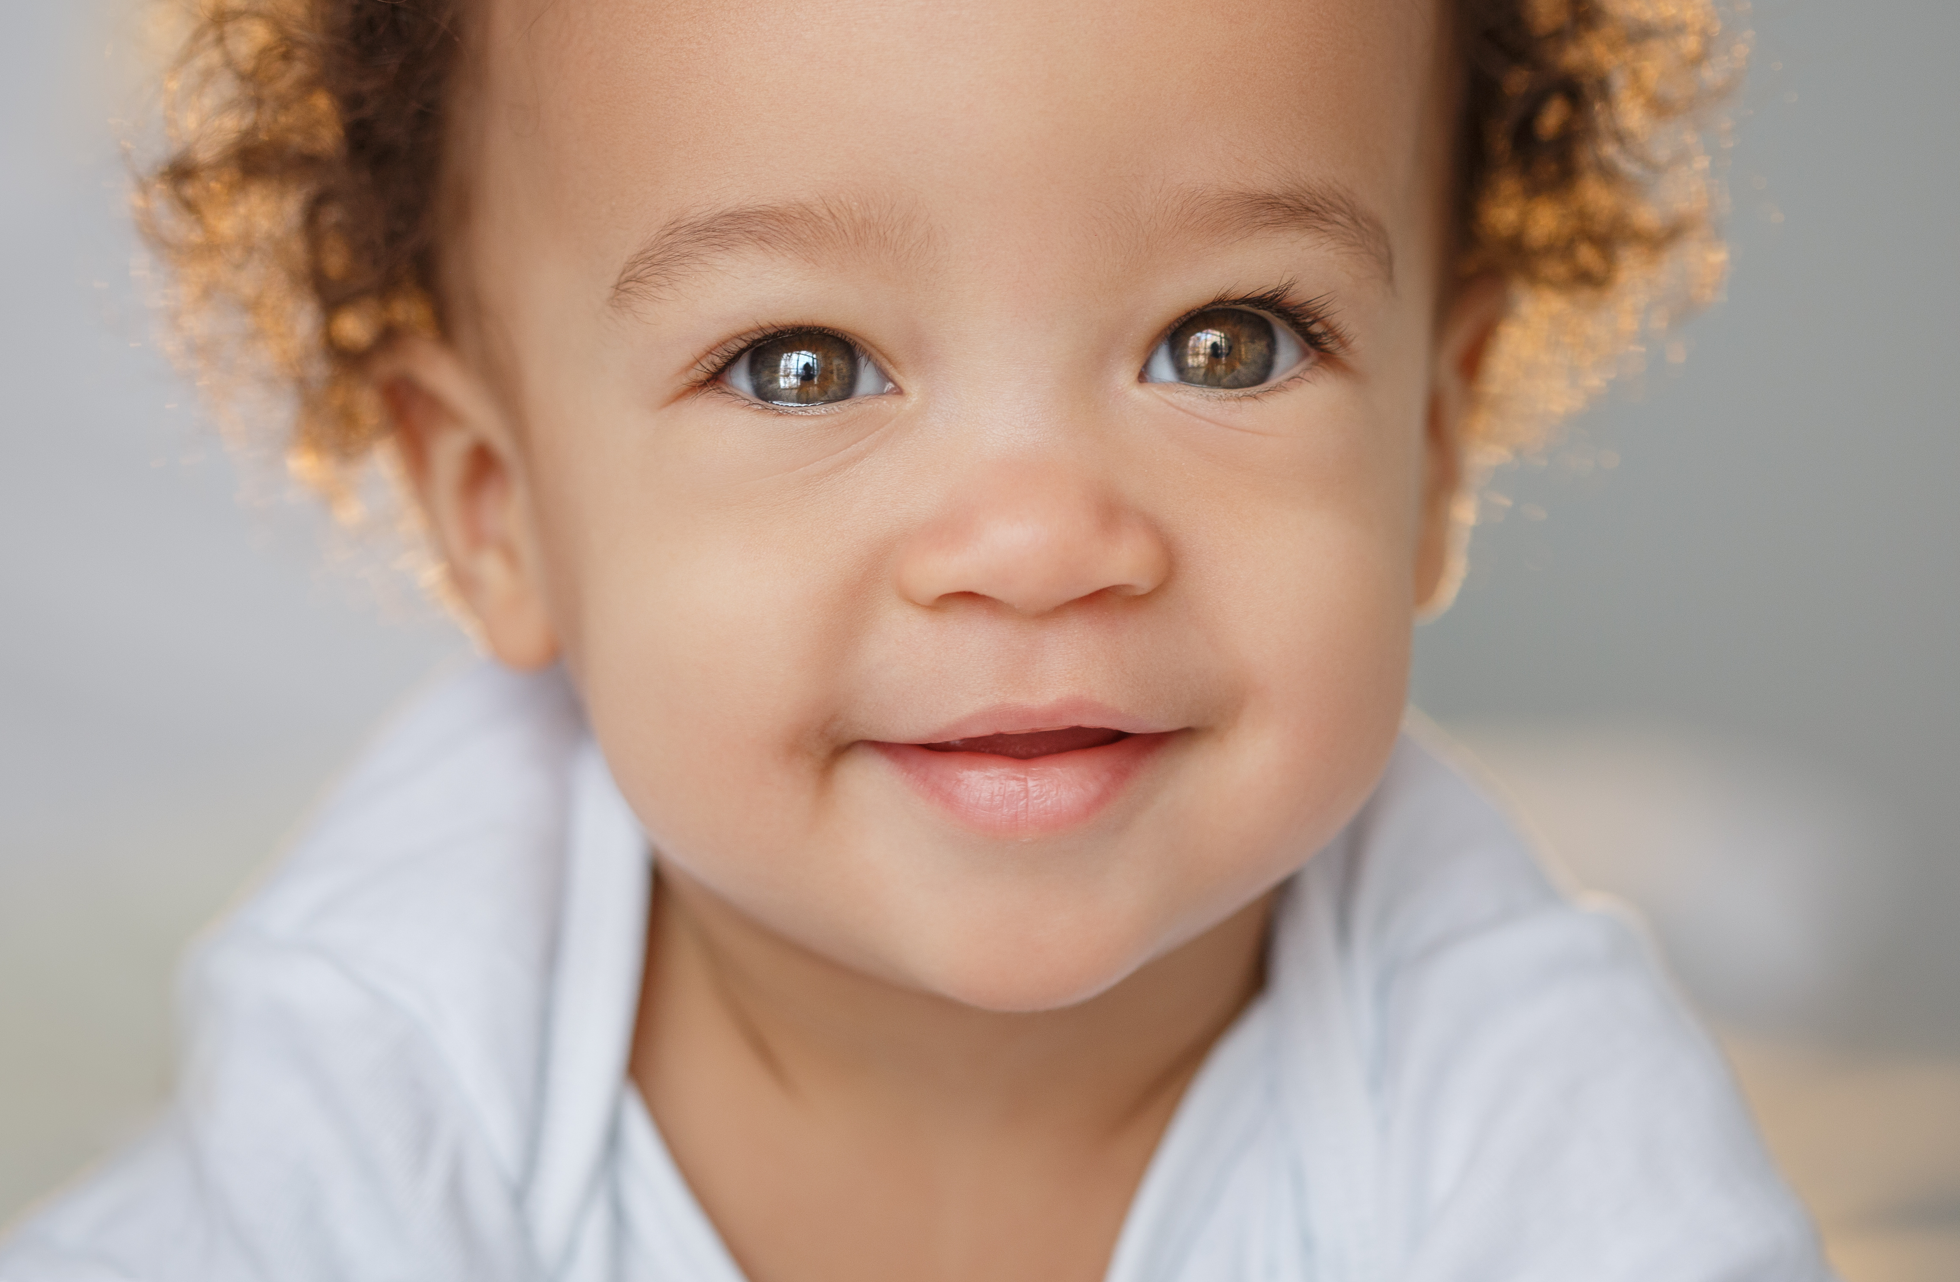
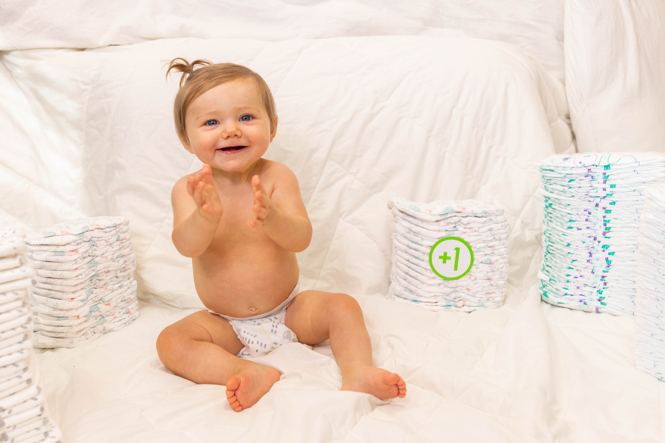
DIAPER DRIVE 2021
OUR GOAL:
Families are in need, now more than ever. One More Child is collecting 1 million diapers by November 14. Join us to help supply the need!
MORE THAN EVER
WE NEED DIAPERS
www.onemorechild.org/diaperdrive

